Slide 1
AES Demo on Hardware (Pi 5 crypto Engine) vs Software (CPU)

Slide 2
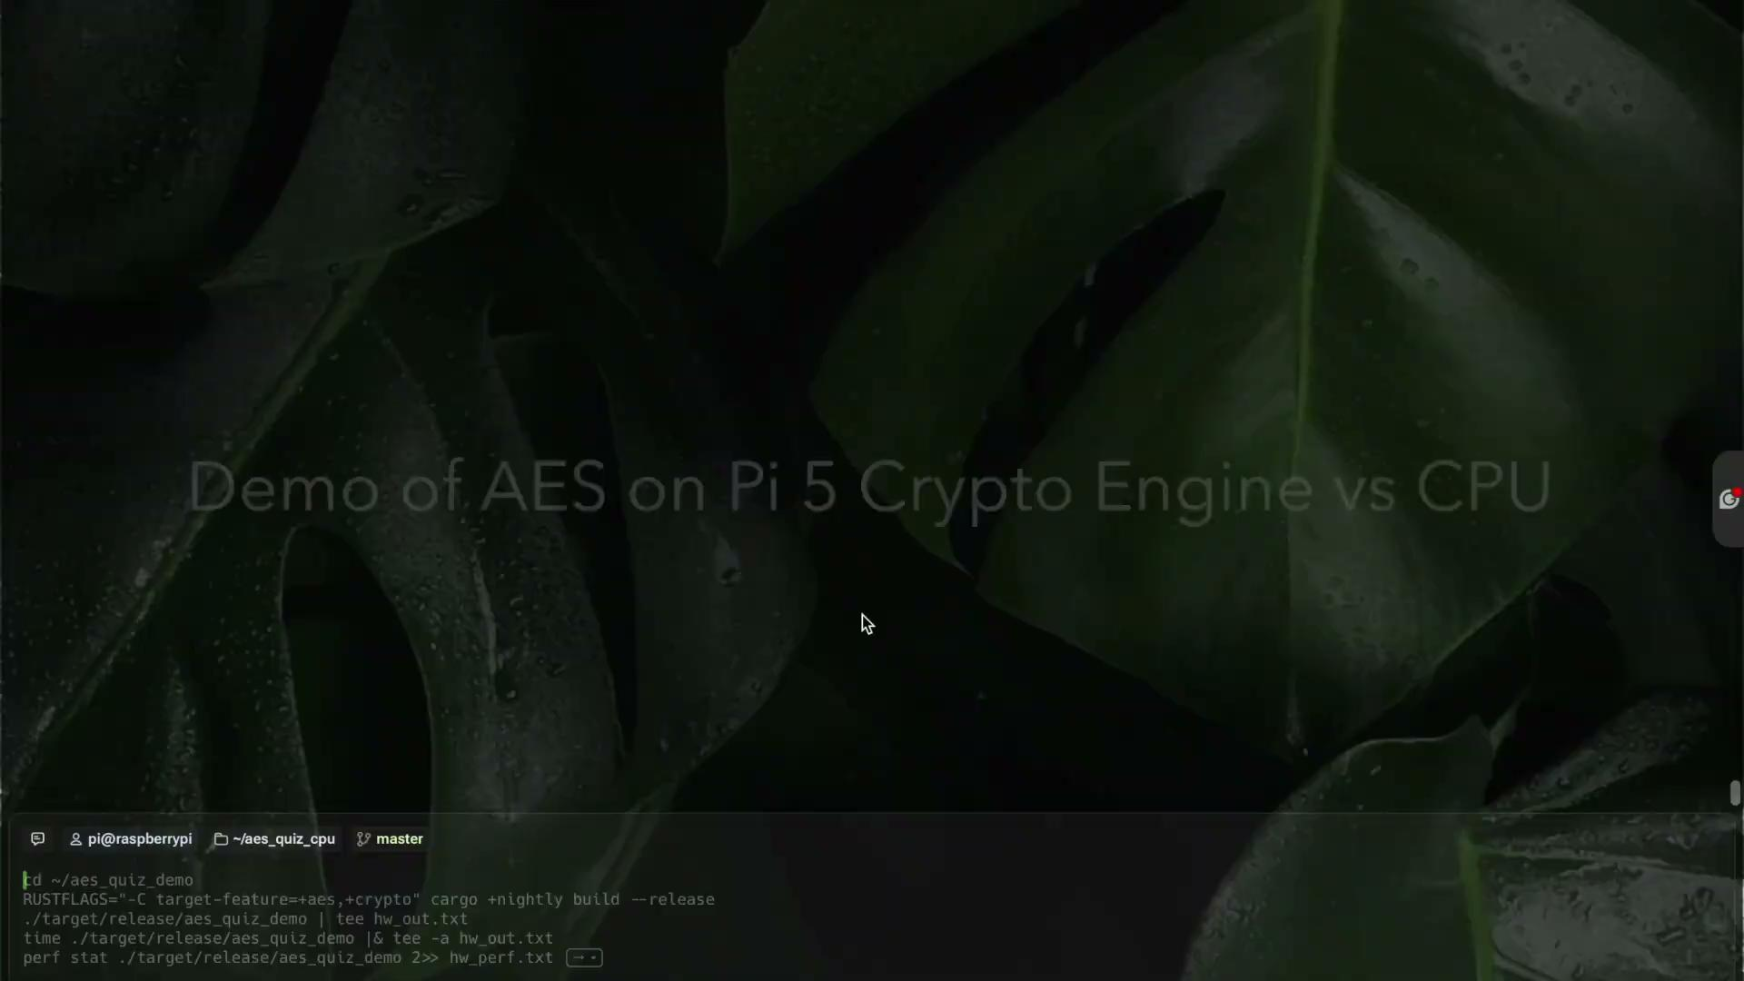

Slide 3
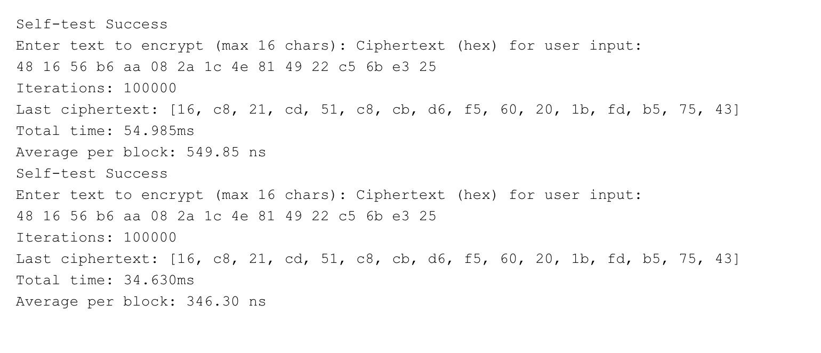
CPU Output
Software AES executed 100 000 blocks in 55 ms (≈ 346 ns per block)

Slide 4
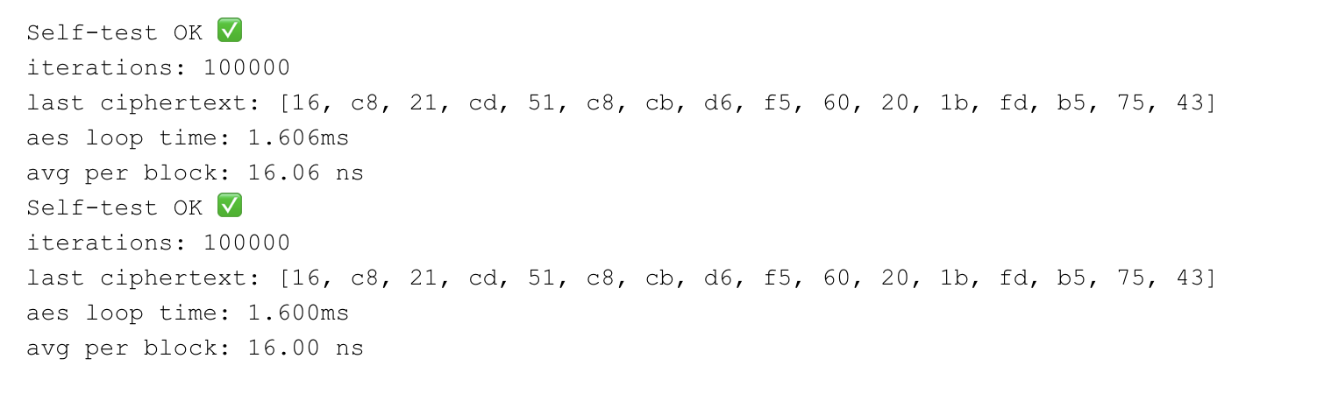
Hardware Output
Hardware AES executed 100 000 blocks in 1.6 ms (≈ 16 ns per block).

Slide 5
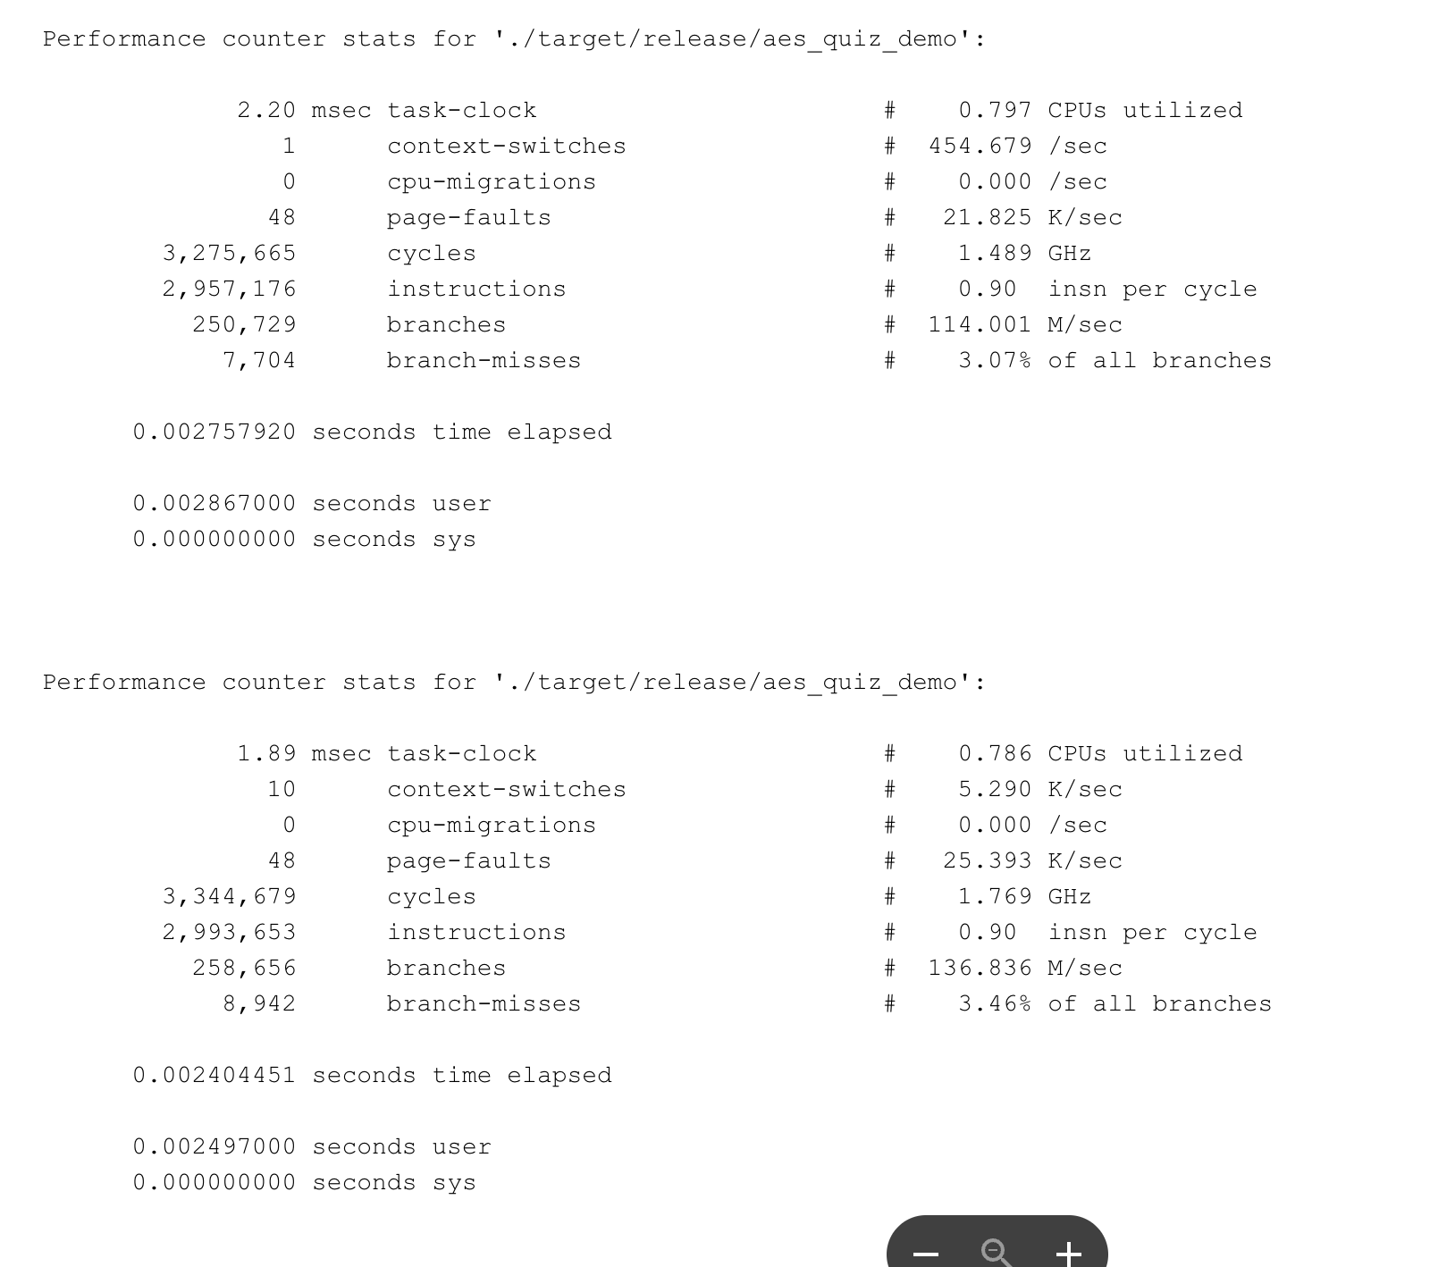
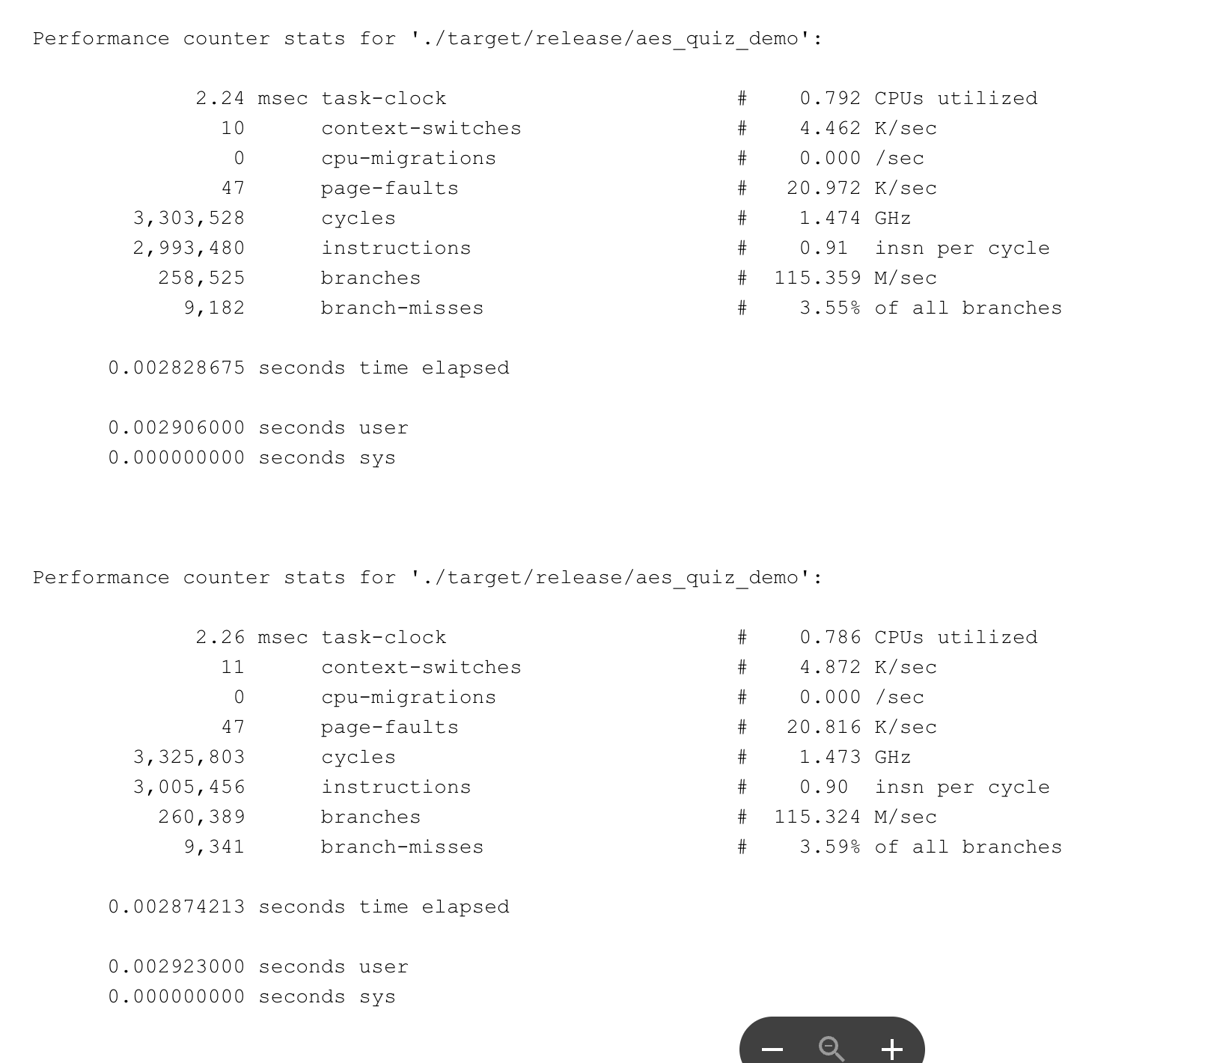
Hardware Performance

